Slide 1
Bangladesh Bank Heist 2016
By: Mirza Kurtovic

Slide 2
Contents
Background
The attack
Further investigation
Analysis
Possible prevention methods
Conclusion

Slide 3
The Heist

Slide 4
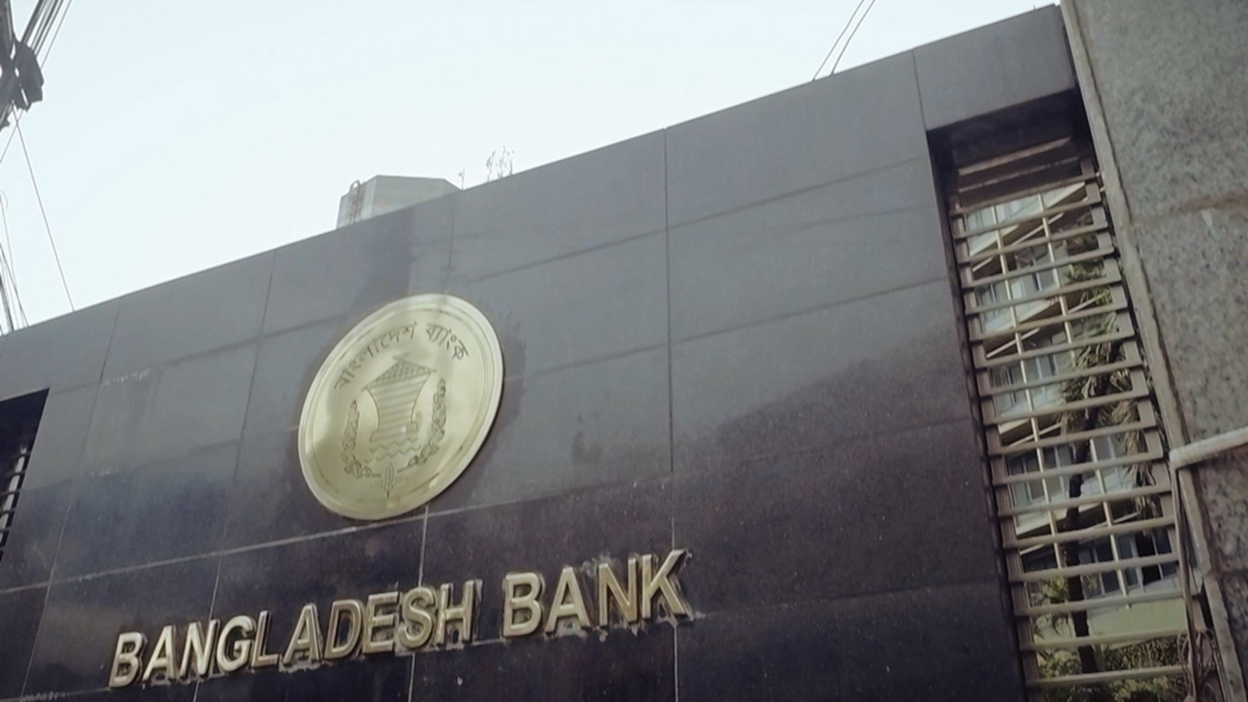

The heist was carried out in February 2016 in Bangladesh
Hackers broke into the Bangladesh Central Bank systems
35 fraudulent transactions totaling $951 million
4 successful transfers, hackers netting $81 million
Dubbed the greatest cyberheist and the greatest bank heist in history

Slide 5
HOW DID IT HAPPEN?

Slide 6
The Attack

Slide 7
The preparation
In May 2015, a group of men opened 4 bank accounts in the Philippines
In January 2016, an employee at the Bangladesh Central bank opens an infected email, compromising the entire internal network
The hackers’ malware was designed to steal credentials and enabled lateral movement to connected systems
32 systems were compromised before moving to machines connected to the SWIFT financial network

Slide 8
The preparation
Hiding in plain sight, the hackers could observe employees and their actions, while learning how financial messages are processed within the SWIFT system
The hackers interfered with connected processes to mask their presence in the system
They detected an automated printer connected to the SWIFT network that printed out backlogs of transactions
The printer was deliberately sabotaged to distract the employees and hide the fraudulent transactions

Slide 9
Initiating the transfers
On February 6th 2016, 35 phony transfers were sent via SWIFT to the Federal Reserve Bank of New York
The details of the requests stated that the funds are to be transferred from New York to various accounts set up across Asia
$20 million USD were transferred to a Pan Asia Bank in Sri Lanka to a non-profit company called the “Shalika Foundation”
$81 million USD arrived to the 4 bank accounts set up under fake identities in a branch of the RCBC bank in the Philippines

Slide 10



Initiating the transfers
The money from the 4 bank accounts was quickly withdrawn and laundered through casinos, where the electronic money transfers were converted to untraceable cash

Slide 11


Initiating the transfers
Unfortunately for the hackers, 30 transfer requests were automatically red flagged due to a company name on the details matching a shipping company blacklisted for evading US sanctions against Iran. $850 million Dollars in total were blocked

Slide 12
Initiating the transfers
Another lucky break was caught when an employee from the Pan Asian Bank in Sri Lanka noticed a spelling mistake on the receiving company’s name. The hackers misspelled “Shalika Foundation” as “Shalika Fandation”. This mistake cost them another $20 million Dollars.

Slide 13
The reaction
By the time the workers at the Bangladesh Central Bank noticed the absurd amount of transfers it was too late.
Joined efforts between the FBI, Philippines and Bangladesh Governments to prevent money laundering in the region proved to be fruitless.
Two of the men responsible for setting up the 4 bank accounts were identified, but they fled to Macau before they could be apprehended

Slide 14
Further investigation
By analyzing the malware in the bank’s systems, Cyber Security experts uncovered similar tools and methods used in many other cyberattacks on financial institutions across the globe.
They uncovered the name of the attackers. It was a group called “Lazarus”
Possible connection with North Korea?

Slide 15
Analysis

Slide 16
Key concepts behind the attack
Masterful reconnaissance
Timing and patience
Selecting attack vector
Escape plan

Slide 17
Conclusion

Slide 18
Possible prevention methods
Spam filters, antivirus protection and awareness trainings
User management and role management by the principle of least privilege
Strong password policy
Use of multi-factor authentication whenever possible
Segmenting networks and securing remote access
Intrusion prevention/detection mechanisms
Monitoring user and account activity do detect threats and implementing secondary verification/review systems on large transfers

Slide 19
THANK YOU FOR
YOUR ATTENTION

